Slide 1
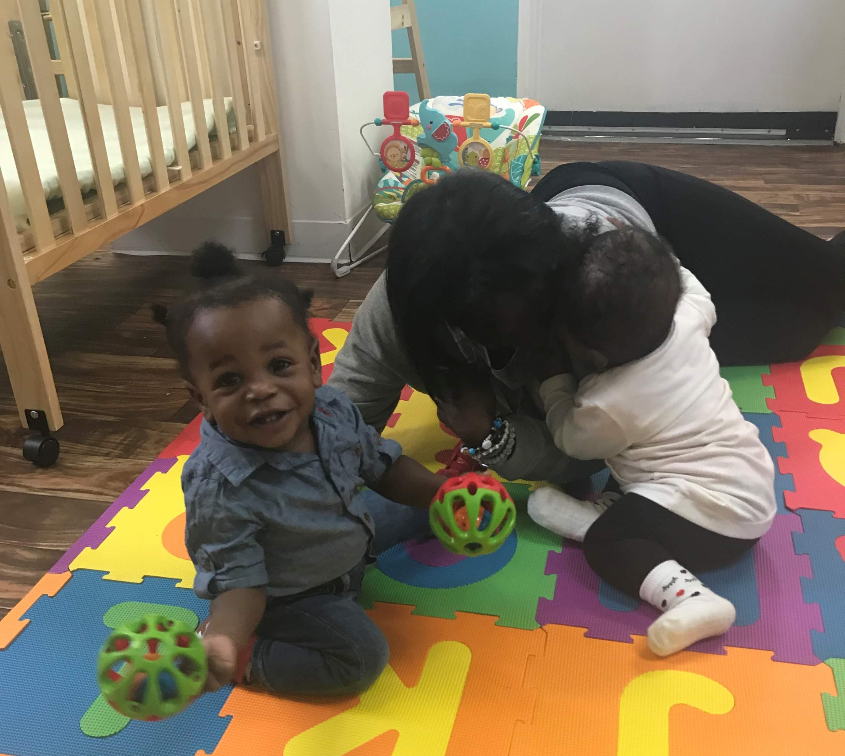
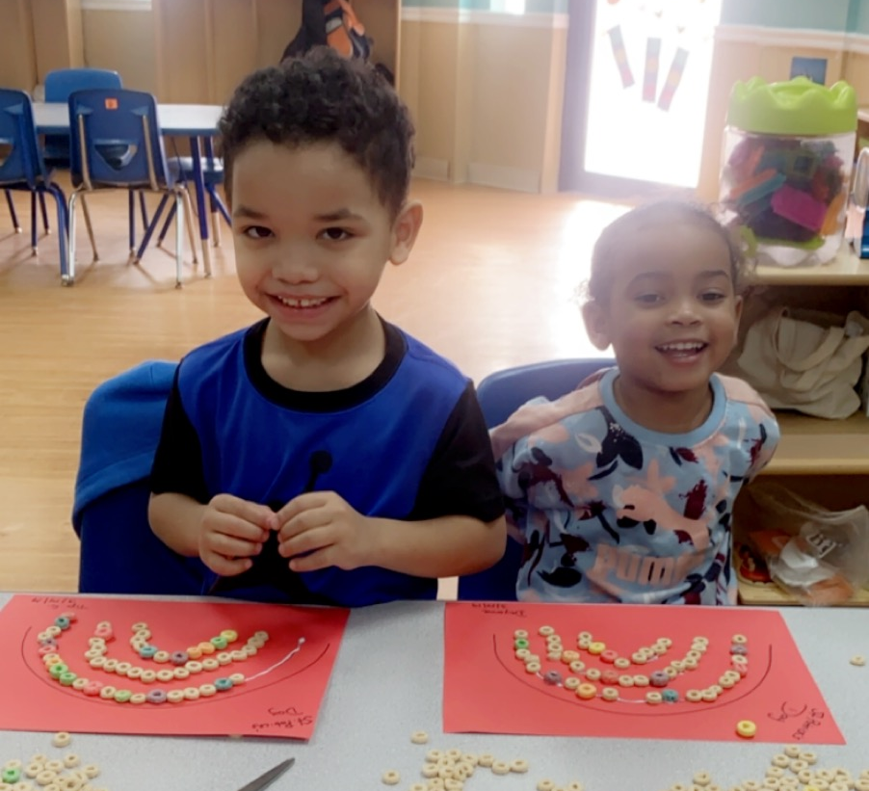
Our Philosophy
At Children Are Unique Academy, we believe in creating positive developmental interactions between children and their surroundings.
The early years of childhood are the most influential in a child’s life. We believe that young children learn most effectively when they have opportunities to explore their surroundings and experience a variety of play. We offer a nurturing, dynamic and diverse environment that encourages a love of learning and connection with others.
Our Mission
Children Are Unique Academy gently encourages children to discover their individual strengths and unique talents.
Each child possesses a marvelous capacity to learn. Not only to we provide quality care, but we also go the extra mile to help every individual child reach his or her full potential. Our teachers and caregivers lead by example, demonstrating that learning is best accomplished in spaces that are emotionally secure, physically safe, and all-around fun!

Slide 2
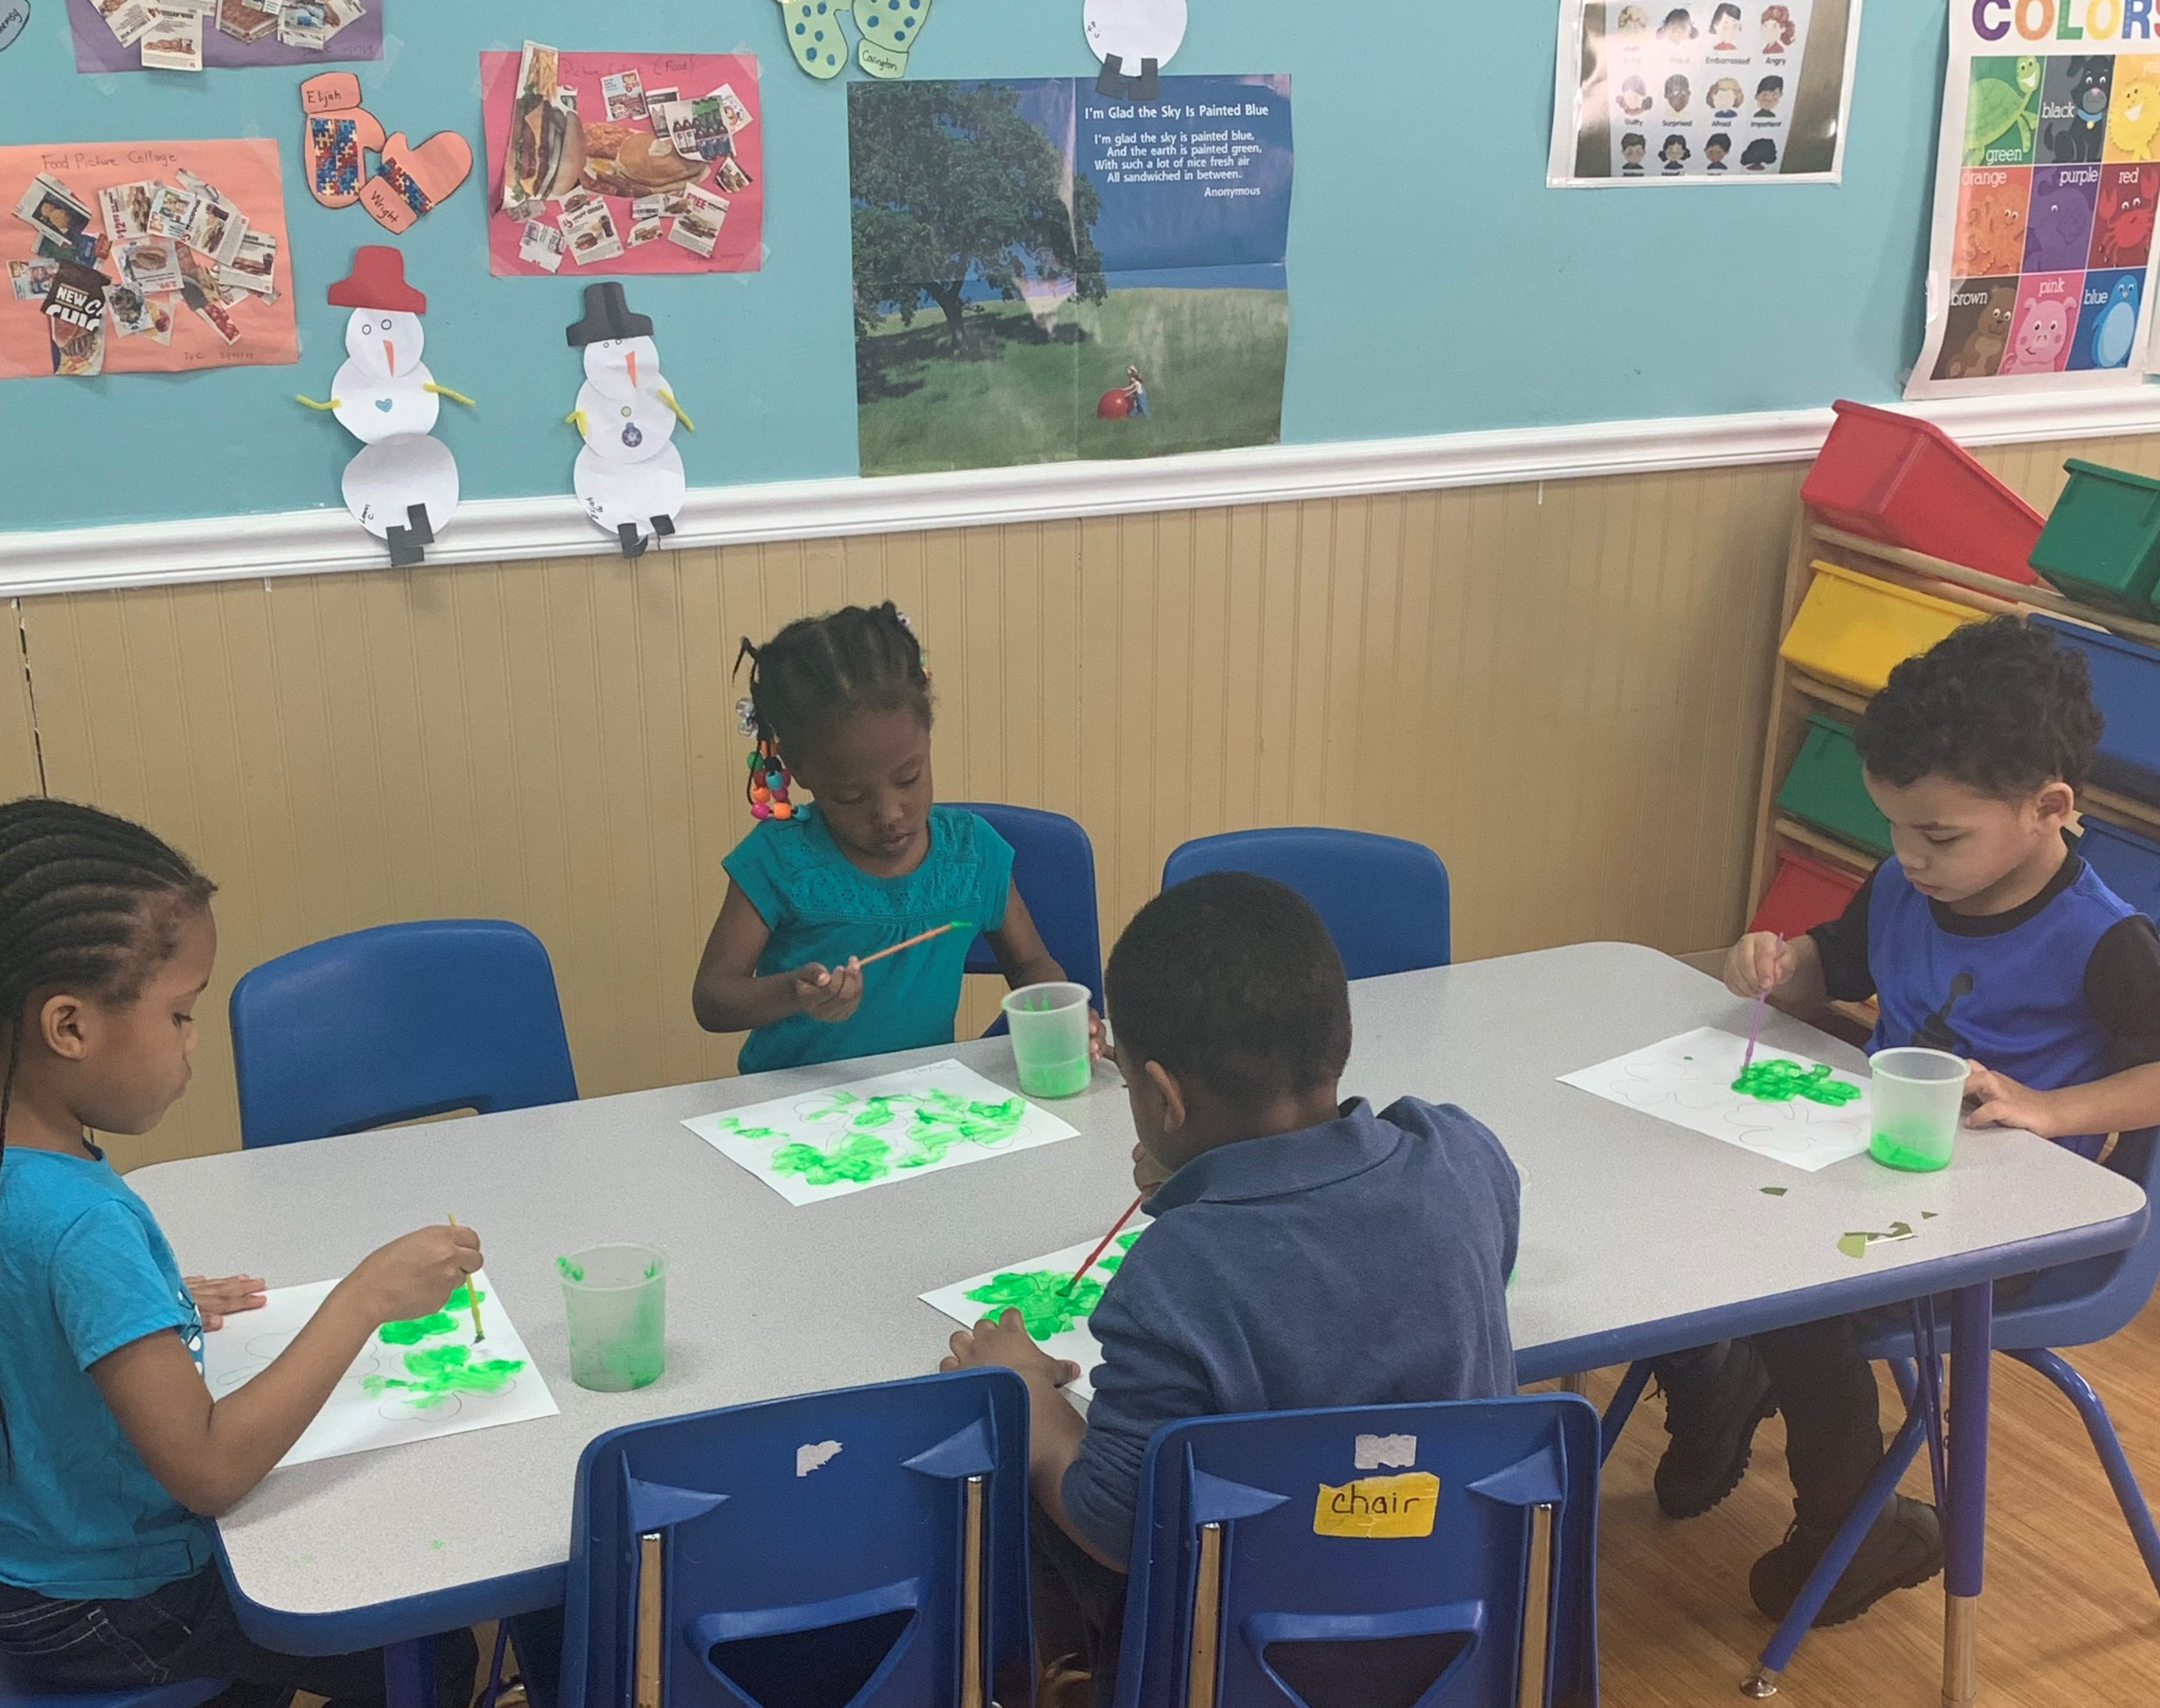
Our Vision
Children Are Unique Academy strives to be a community where caregivers and families work together to nurture happy, healthy, and bright children.
We build trust with the families we support. We aim to create an environment where families feel confident about their child’s learning and development. By working in partnership with one another, we are able to give all children a sense of dignity, respect, and most of all, community.
Qualified Teachers
Our teachers are compassionate, trained caregivers.
Nutritious Meals
We offer breakfast, lunch, and snacks throughout the day.

Slide 3
Flexible Scheduling
We operate 6 AM-9 PM Sunday-Saturday, offering morning, daytime and evening care.
Facility Features
We have two buildings and an outdoor play area for children ages 6 weeks to 12 years old.

Slide 4
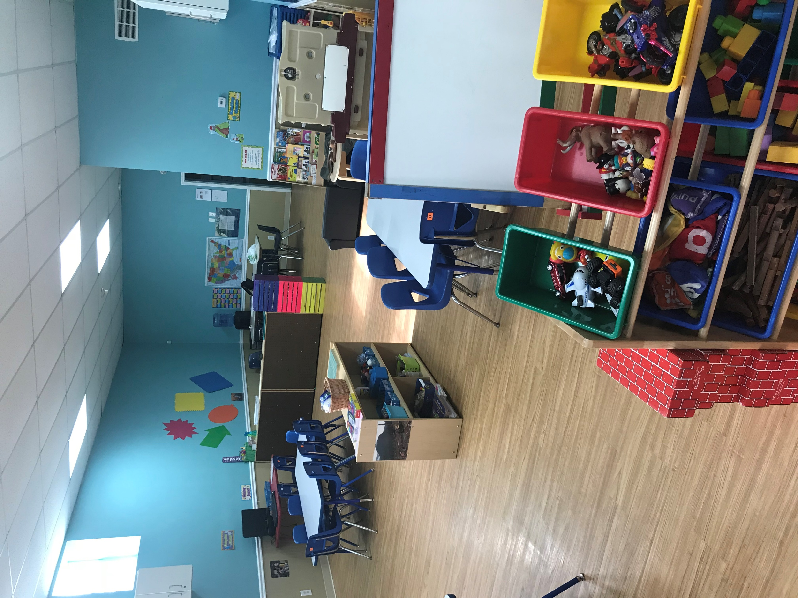
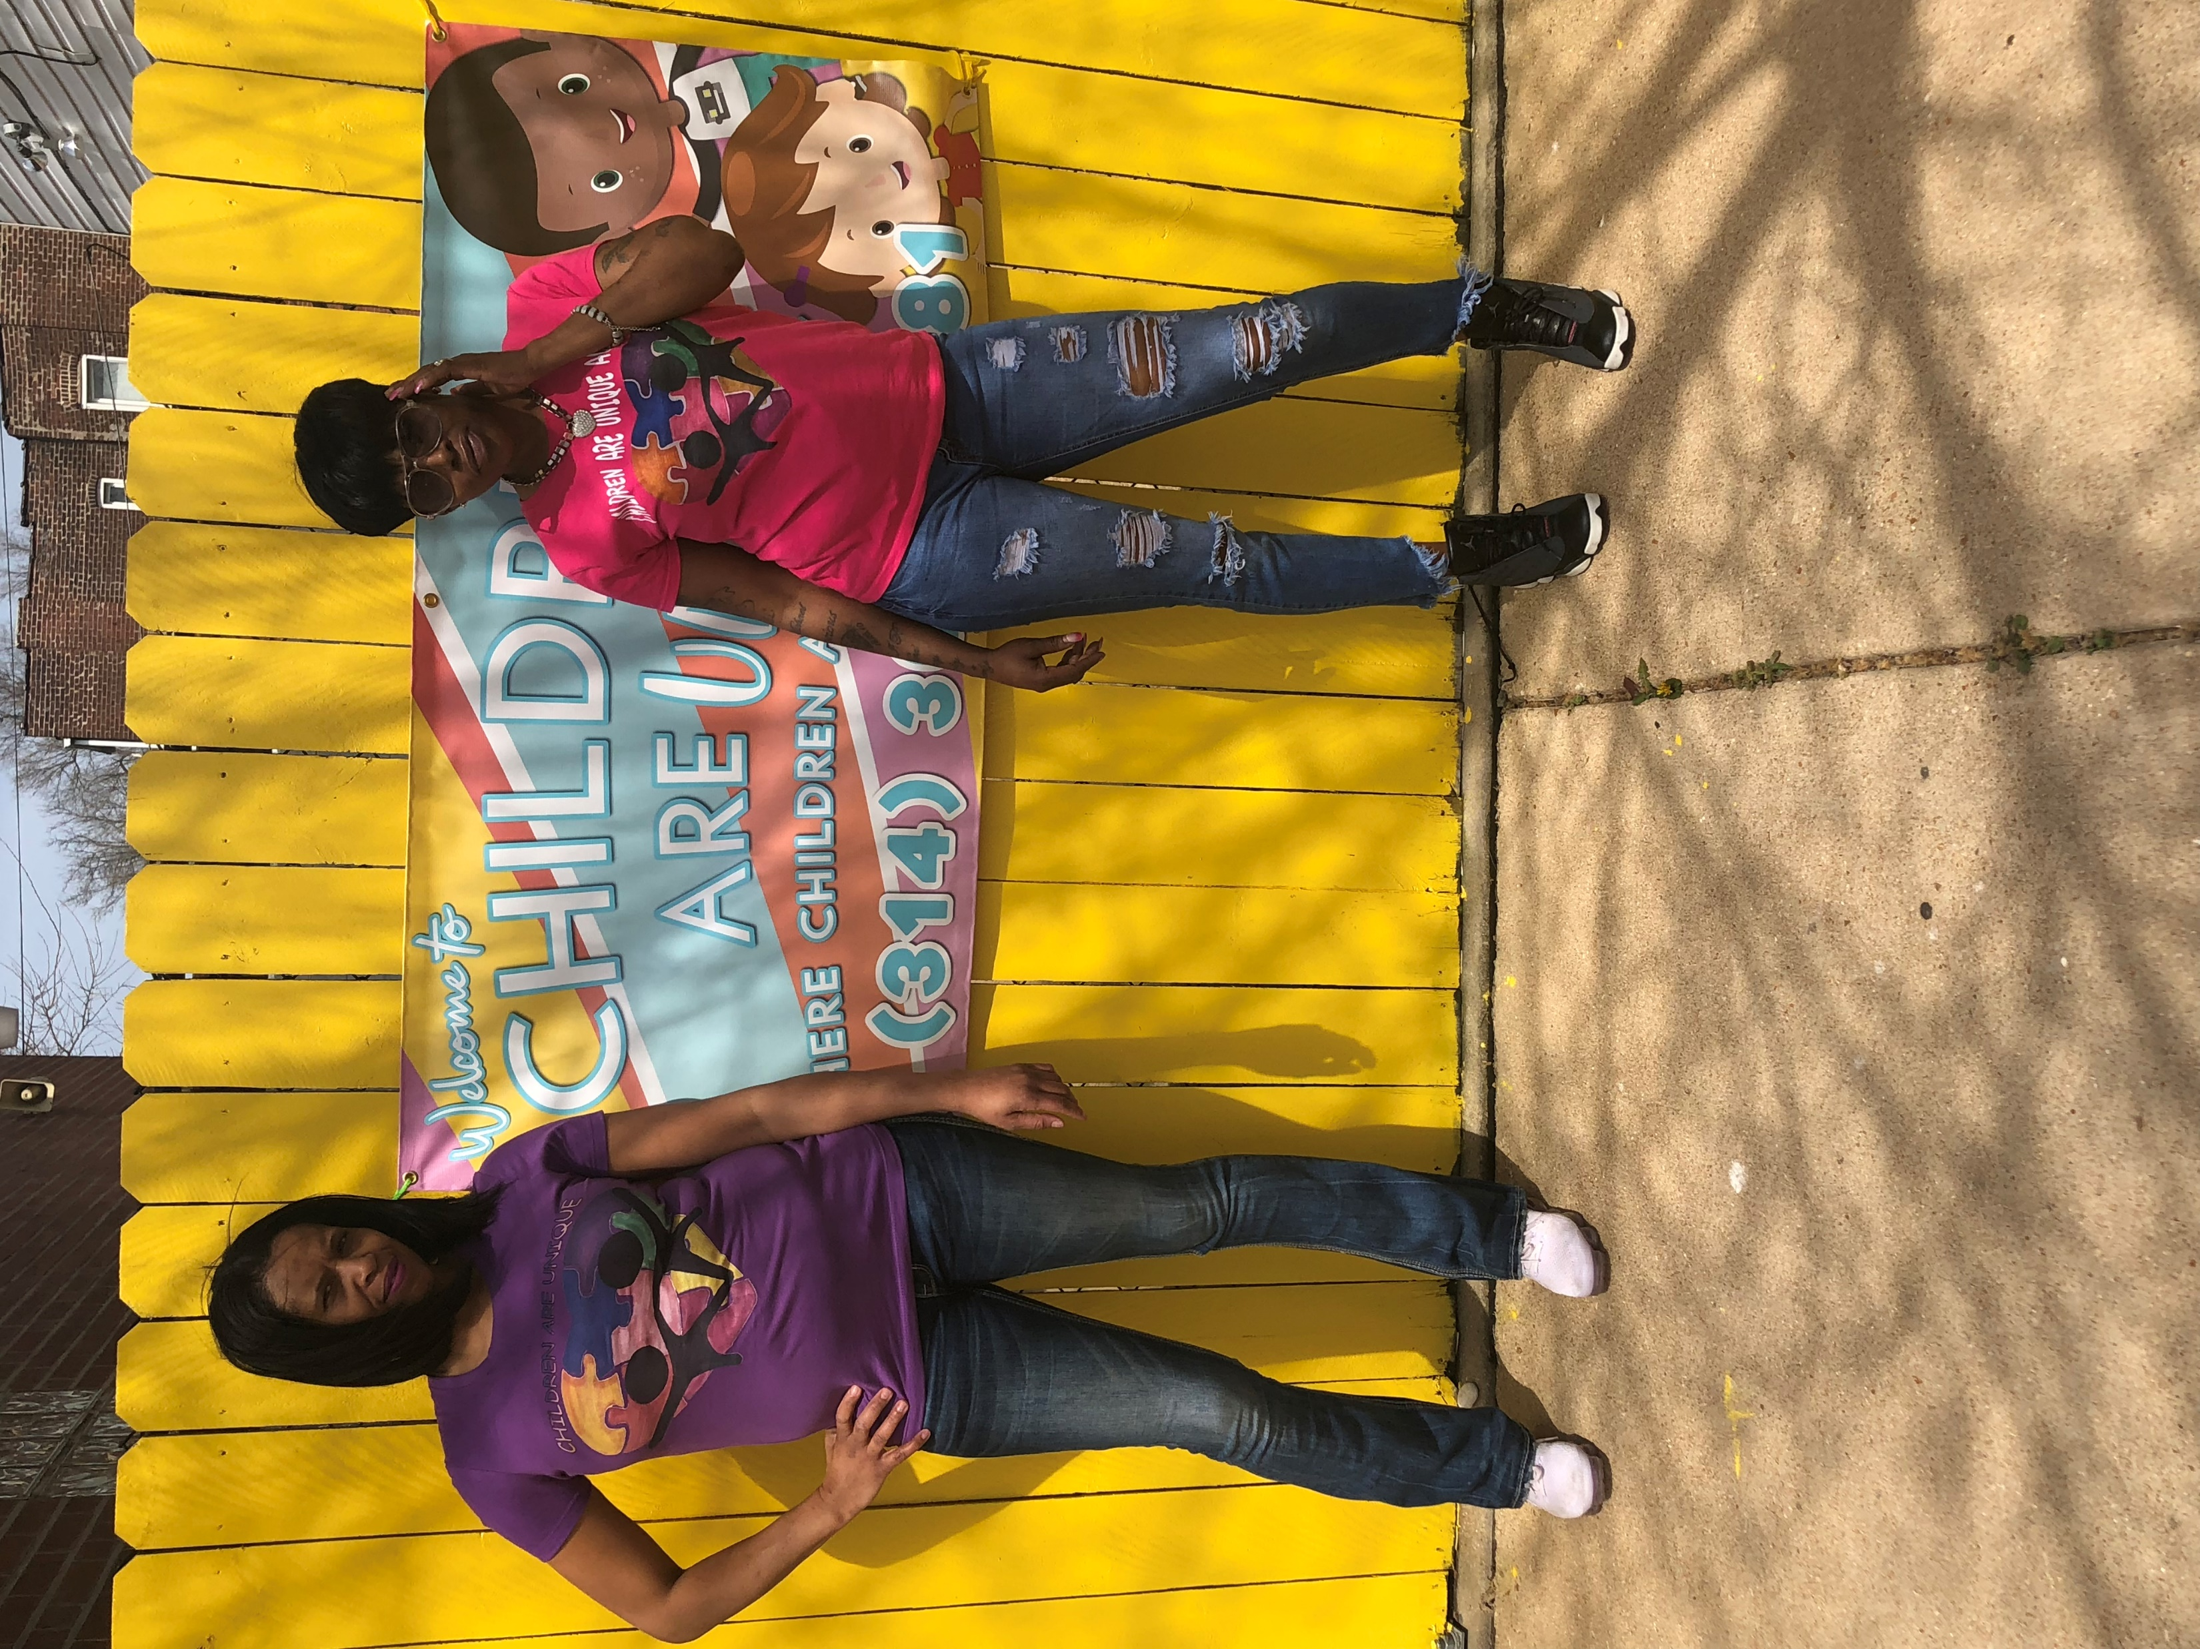
Program
Open Sunday-Saturday from 6 AM – 9 PM, we offer all-day care for children who are 6 weeks old to preschool-aged. We have one building for infants and toddlers, and a larger building for preschoolers. We also offer before and after-school care for elementary and middle school children (ages 6-12) in our larger building. We consult with families to create a program that makes sense for them and their busy schedules.
A Brief History
Children Are Unique Academy was founded in 2017 by Annette Smoote and Sherri Cole, who believe that all children are unique no matter their race, ethnicity or gender. Both women had over 24 years of experience working with children, and so they used their combined skills to form and operate their own childcare center. Annette and Sherri wanted to create a place where parents knew their children would be safe and well taken care of. Today, Annette and Sherri are fully committed to running a top-quality daycare center and go above and beyond to make sure everything runs smoothly.

Slide 5
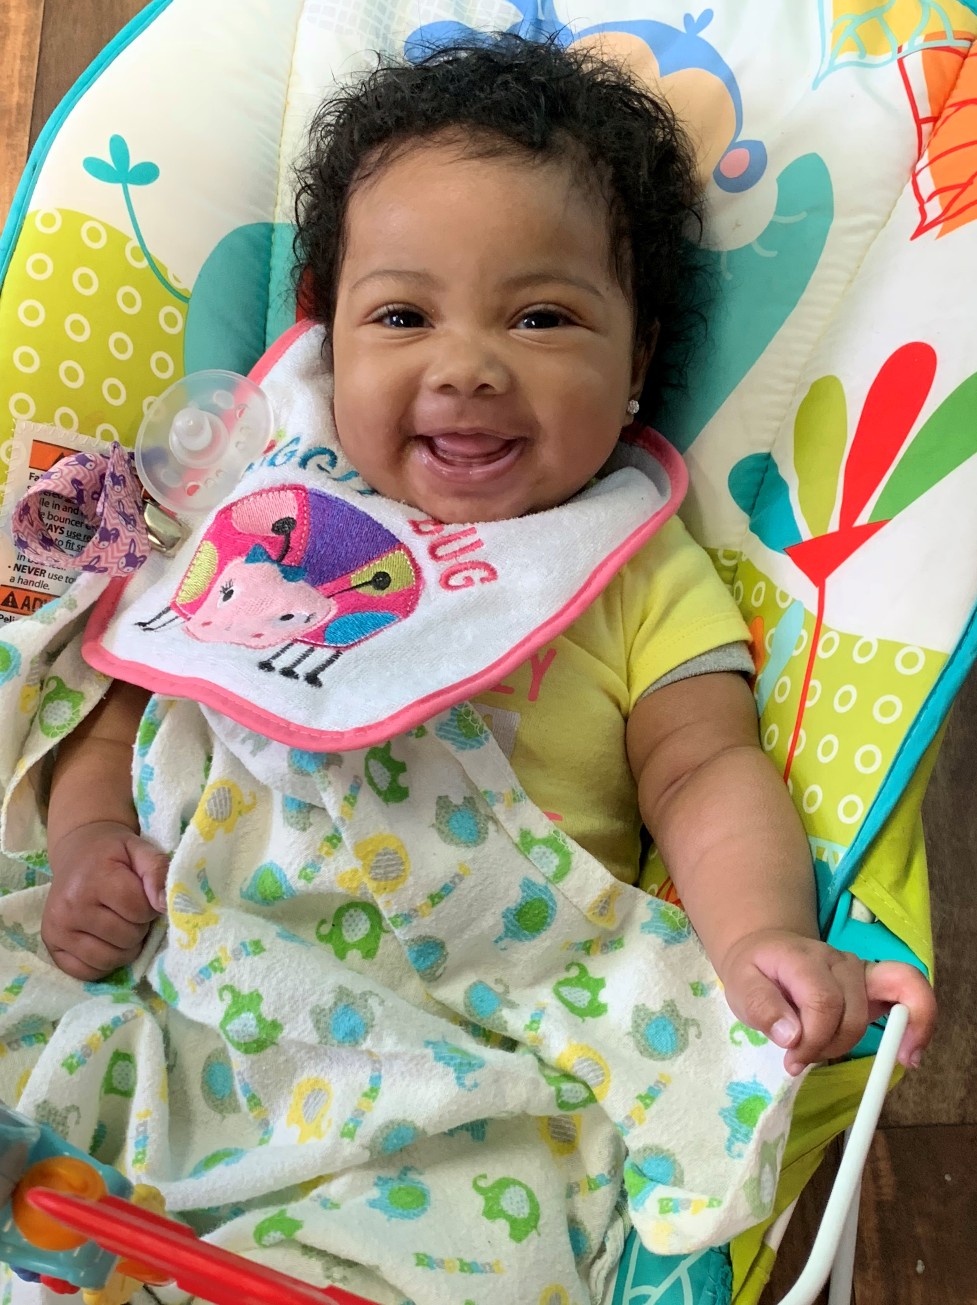
To begin the enrollment process, call us at 314-300-8481 to schedule a tour of Children are Unique Academy. Together, we will develop a plan that makes the most sense for you and your child.
We invite parents and guardians to enroll their children ranging in age six weeks through twelve years to apply for full- or part-time care. They will be considered without regard to race, color, national origin, gender, age, religion, disability, or any other basis protected by federal, state, or local law.
Below are mandatory documents needed in the enrollment process. We encourage you to fill them out as soon as possible.
For all children:
Childcare Enrollment Form.PDF
For Infants/Toddlers:
Infant & toddler Feeding and Care Plan.PDF
For Infants/Toddlers/Preschoolers:
Child Medical Examination Report.PDF
For School-Age Children:
Parents Health Statement for School-Age Child.PDF

Slide 6
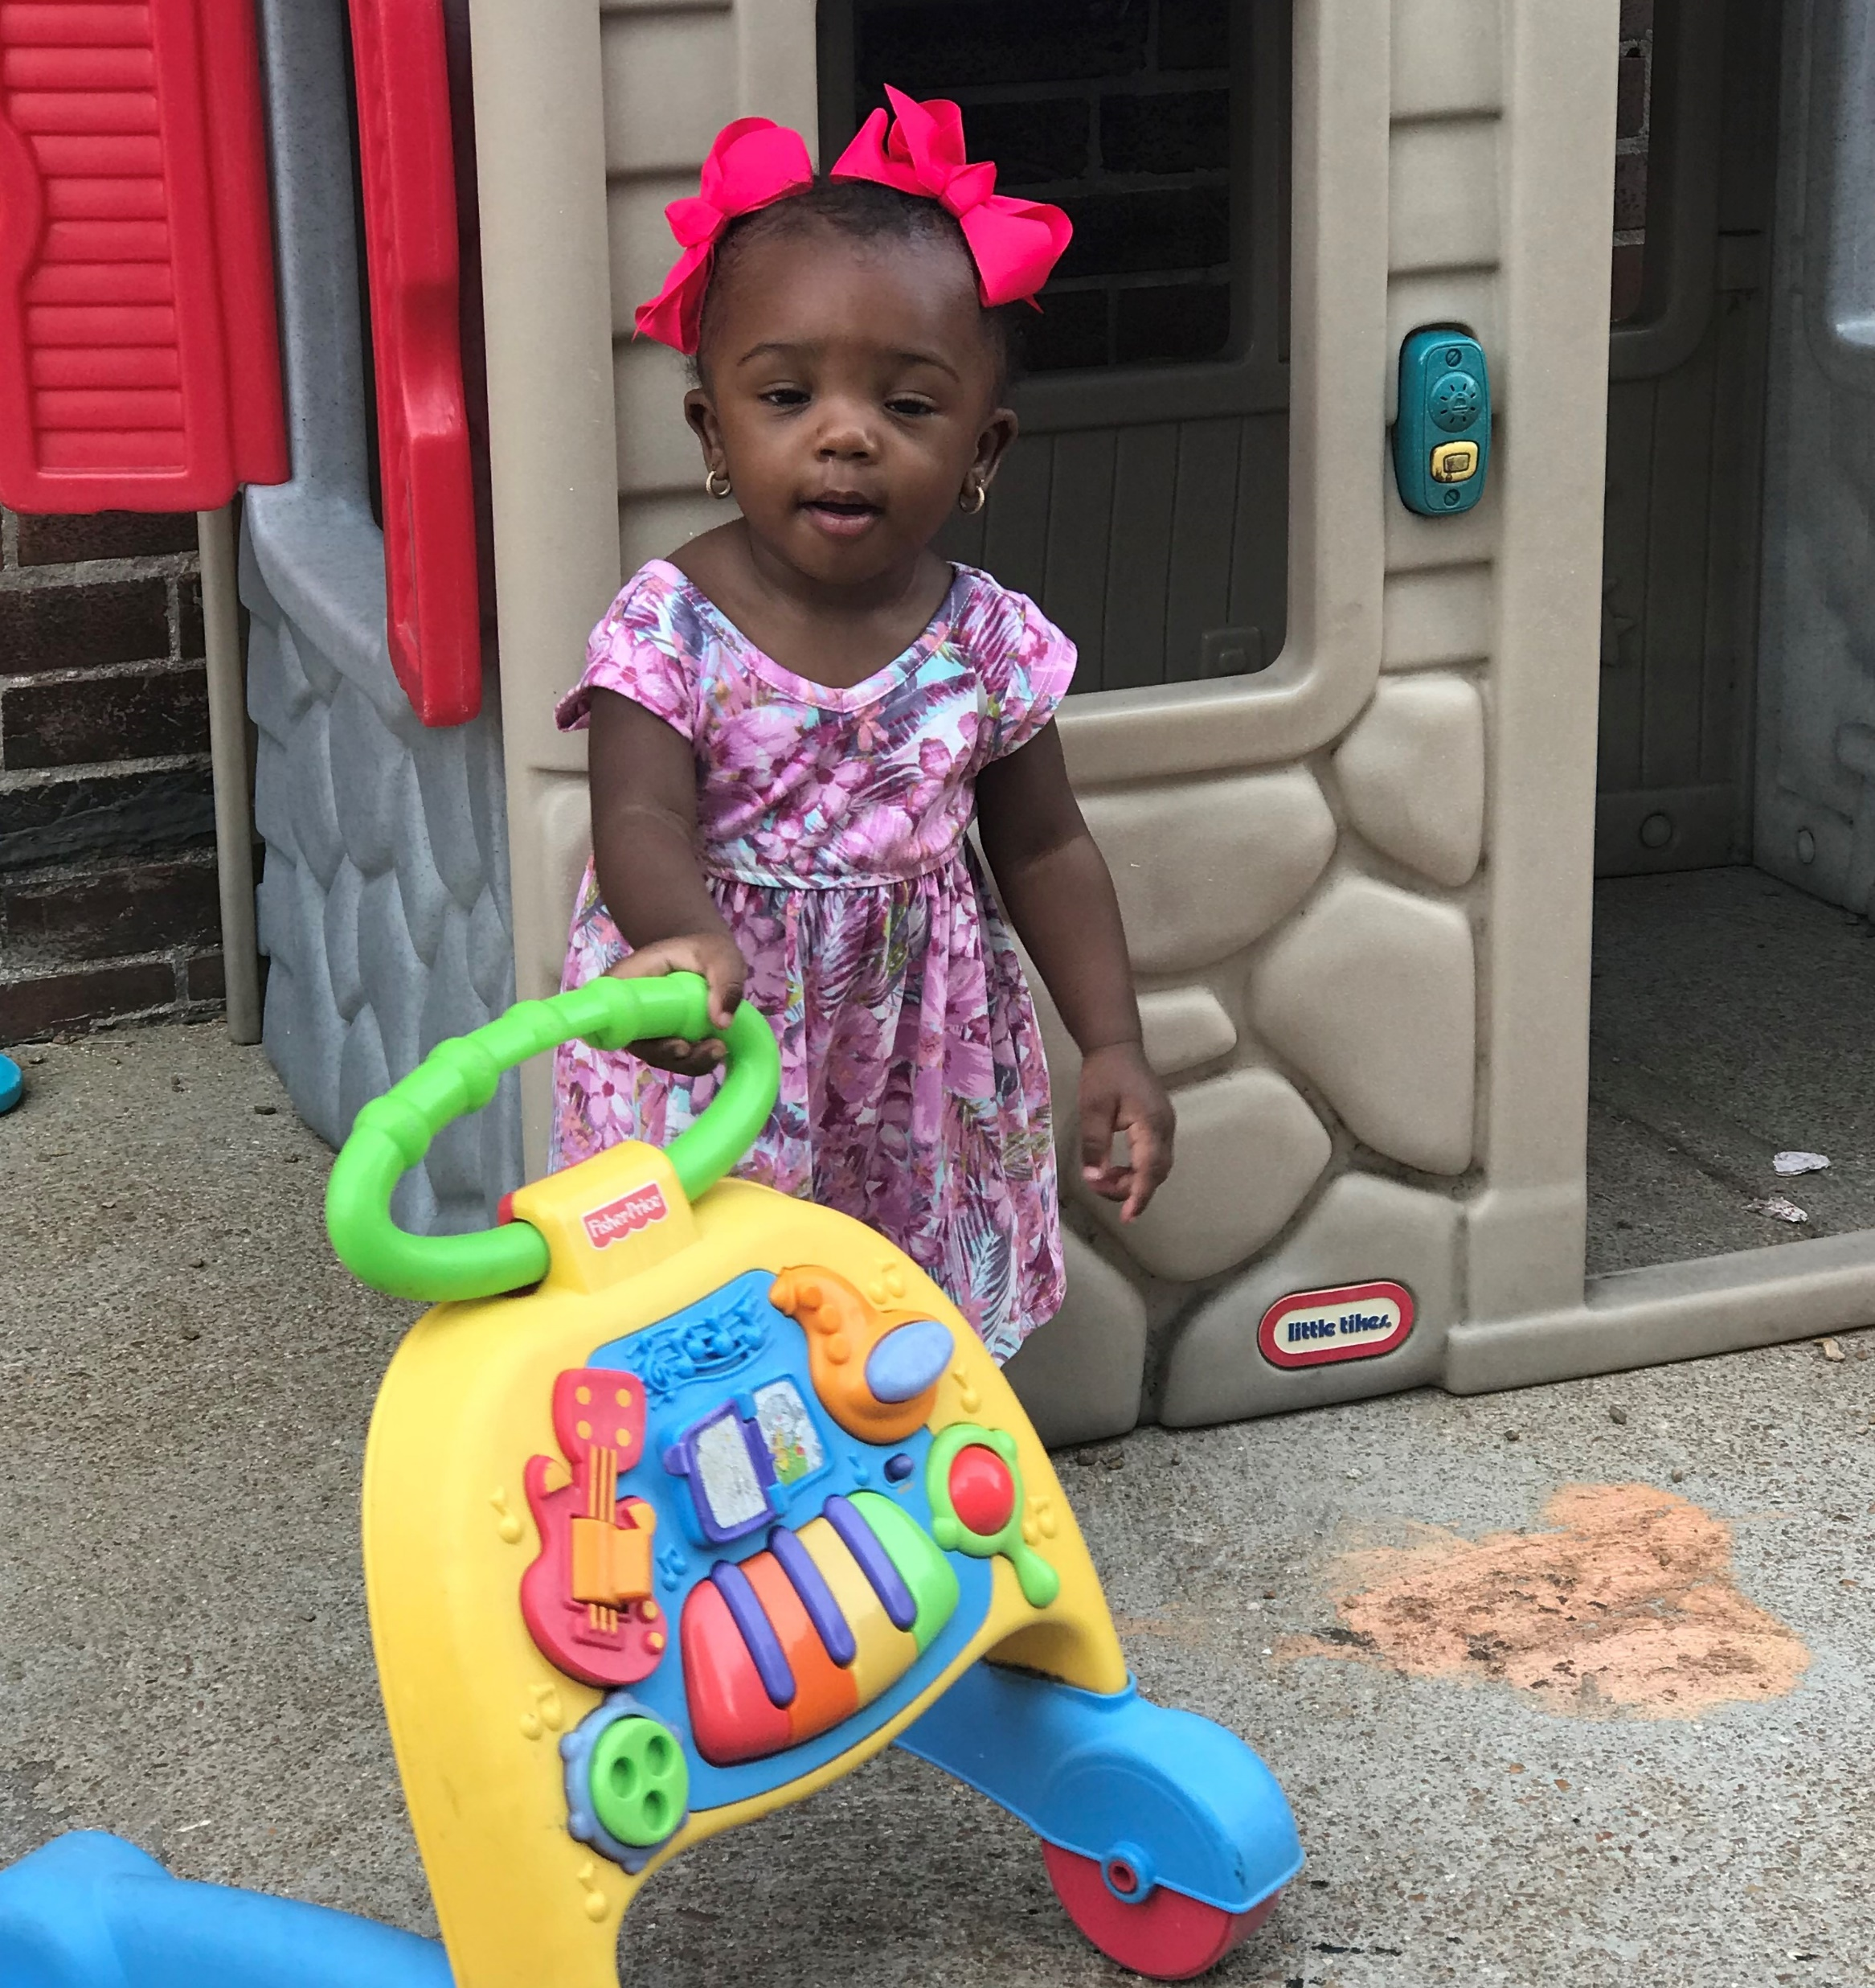
About Us
Children Are Unique Academy was founded in 2017 by Annette Smoote and Sherri Cole, who believe that all children are unique no matter their race, ethnicity or gender. Both women had over 24 years of experience working with children, and so they used their combined skills to form and open their own childcare center. Annette and Sherri wanted to create a place where parents knew their children would be safe and well taken care of. Today, Annette, Sherri, and their team of kind and knowledgeable teachers are fully committed to this top-quality daycare center. They go above and beyond to make sure everything runs smoothly.

Slide 7

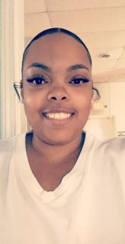

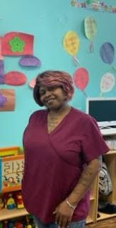
Meet Our Teachers
Hello, my name is Annette and I’m one of the co-founders of Children Are Unique Academy. I’ve worked with children for over 25 years. I have an AAS Degree in Early Care Education and a BA Degree in Human Services. I’ve worked with all age groups from 6 weeks to 14 years of age, both in daycare and preschools, in the classrooms and also as a supervisor. Working with children is one of my most rewarding experiences. What amazes me most is seeing my old students who still remember me. There isn’t anything I would rather do than work with children and their families—it’s my passion!
Hi, I’m Ms. Star and I have a passion for children. I love to watch children explore and learn new things. It’s so amazing watching little children grow up. Being able to enjoy them is wonderful, but it is also amazing to assist the parents. These children are my #1 priority and I’ll do any and everything in my power to make sure that they are properly cared for and safe. I have 10 years of experience working with children and am looking forward to many more.
Hello, my name is Alexis and I've been working at Children Are Unique Academy since March 2018. I will be finishing my degree at Forest Park Community College and taking Early Care Education classes. I have 6+ years of experience working with children and find it rewarding. My passion is working with children, and my goal is to make each child I teach excel before leaving for kindergarten.
Hi my name is Lela, and I have 22 years of experience working in childcare. I have a passion for children; they are unique and I like to watch them learn and grow. I take pride in working with all age groups because I know that one day they will become someone important. I love them all and wouldn't want to work in any other field.

Slide 8


My name is Jenny, I’m 34 years old, and married with four kids. I went to college to pursue a career in the medical field, up until a year ago when I came to Children Are Unique. I became a teacher to contribute to my community in a meaningful way, and teaching is one of the most direct ways to make an impact. What parents can expect out of my two-year-old class is for me to provide fun learning experiences that encourage their young toddler to explore their environment and interact with peers and teachers. Children in my classroom are introduced to different types of learning experiences based on their individual developmental needs and interests.
Hello my name is Gloria, and I've been working at Children Are Unique since they opened in March 2018. I enjoy working with the infants and find it to be so much fun. I've really become attached to all of the babies. In my spare time, I like going to the stores just to find something to buy for the little ones.

